Slide 1
Live Format: Preparation Instructions
Work with the CE Sponsor to determine the following:
General experience level of your audience
Estimated size of the audience
Delivery format in-person vs. webinar
Practice the live delivery with timing to determine which required exercises are needed for your specific audience
Every learning objective module must include the use of required exercises
Not all of the required exercises per module may be needed depending on size and scope of the audience
All live delivery should be completed at 2-hours
Utilize all content slides as is
Required Exercise slides should be modified as per the instructor’s need
Prepare to switch from the presentation to videos or case studies often as part of the instruction

Slide 2
Live Format: Delivery Instructions
Utilize all of the instructor notes in the presentation.
Instructor notes may be read directly as a script, or
Modified for your audience, but all instructor notes must be utilized in your presentation
Implement all required exercises as assigned in this presentation based on your timed practice session
Follow all other guidance and policies in the CE Sponsor Terms and Conditions related to Ethics CE

Slide 3
ETHICS CE: CFP Board’s Revised
Code and Standards
Program sub-title (if applicable)
Presenting Organization
Date of presentation
Notes:
**Add: Sub-title, presenting organization name, date of presentation

Slide 4
Disclaimer
The content of this program is based on CFP Board’s Code of Ethics and Standards of Conduct (Code and Standards), which became effective on October 1, 2019.
CFP Board created and provided this slide deck to the CE Sponsor for presentation. The presenter’s opinions do not necessarily represent those of CFP Board.
All material associated with this program is the property of CFP Board and may not be resold, republished or copied without the prior written consent of CFP Board.
Copyright© 2020 Certified Financial Planner Board of Standards, Inc. All rights reserved. Reproduced with permission.
Notes:
Note: This disclaimer must be displayed at the beginning of the program – no need to read it out loud.

Slide 5
LEARNING OBJECTIVES
Understand the structure and content of the revised Code and Standards, including significant changes from prior rules.
Describe CFP Board’s Fiduciary Duty.
Identify Material Conflicts of Interest and How to Avoid, or Fully Disclose, Obtain Informed Consent, and Manage Them.
Understand the Duty to Report to CFP Board and the Duty to Cooperate.
Identify the Practice Standards When Providing Financial Advice that Requires Financial Planning or Financial Planning.
Understand the Duty to Provide Information to Clients When Providing Financial Advice and/or Financial Planning.

Slide 6
understand the structure and content of the revised Code and Standards, including significant changes FROM PRIOR RULES.
LEARNING OBJECTIVE 1
Notes:
Module 1: Learning Objective 1
Let’s focus on the structure and content of the Code and Standards, as well as some of the significant changes set forth in the Code and Standards.

Slide 7
The Revised Code and Standards
New Structure and Organization
Overview of the Duties of a CFP® Professional
Introduction to Significant Changes to Content
Fiduciary Duty
Conflicts of Interest
Duty to Report and Duty to Cooperate

Slide 8
Preamble to the Code and Standards
CFP Board’s Code of Ethics and Standards of Conduct reflects the commitment that all CFP® professionals make to high standards of competency and ethics. CFP Board’s Code and Standards benefits and protects the public, provides standards for delivering financial planning, and advances financial planning as a distinct and valuable profession. Compliance with the Code and Standards is a requirement of CFP® certification that is critical to the integrity of the CFP® marks. Violations of the Code and Standards may subject a CFP® professional to discipline.
Notes:
The revised Code and Standards opens with a brief, descriptive Preamble that captures the purpose and effect of the Code and Standards. A short Code of Ethics then delineates the general principles that guide the behavior of CFP® professionals, with elaboration provided in the Standards of Conduct that follow.

Slide 9
Code of Ethics
A CFP® professional must:
Act with honesty, integrity, competence, and diligence.
Act in the client’s best interests.
Exercise due care.
Avoid or disclose and manage conflicts of interest.
Maintain the confidentiality and protect the privacy of client information.
Act in a manner that reflects positively on the financial planning profession and CFP® certification.
Notes:
CFP Board’s Code of Ethics and Standards of Conduct reflects the commitment that all CFP® professionals make to high standards of competency and ethics. The Code of Ethics applies at all times, and sets forth principles that guide the behavior of CFP® professionals, with elaboration provided in the Standards that follow. The cornerstone of the Code and Standards is a CFP® professional’s duty to act as a fiduciary and, therefore, act in the best interests of the Client at all times when providing Financial Advice.
The Code of Ethics is principles-based and always applies. For example, the first item listed in the Code is to act with honesty, integrity, competence, and diligence. The last item provides that a CFP® professional must act in a manner that reflects positively on the financial planning profession and CFP® certification. Each item listed in the Code of Ethics is addressed more specifically in the Standards of Conduct.

Slide 10
Standards of Conduct – Six Sections
A. Duties Owed to Clients | D. Duties Owed to Firms and Subordinates
B. Financial Planning and Application of the Practice Standards for the Financial Planning Process | E. Duties Owed to CFP Board
C. Practice Standards for the Financial Planning Process | F. Prohibition on Circumvention
Notes:
The Standards of Conduct is composed of six sections.
Duties Owed to Clients – This section sets forth 15 “duties” that CFP® professionals owe to clients, such as the fiduciary duty, which we will discuss in greater detail today.
Financial Planning and Application of the Practice Standards for the Financial Planning Process – This section updates the definition of “Financial Planning” and the standard for determining when Financial Planning is required.
Practice Standards for the Financial Planning Process – This section updates the Practice Standards by beginning after the Engagement is formed. It also reorders and expands upon the previous steps of the Financial Planning process. The result is that there are now seven steps in the Financial Planning process.
Duties Owed to Firms and Subordinates – This section updates the previous standard for supervising persons acting under the CFP® professional’s direction, following firm procedures, and notifying the CFP® Professional’s Firm about CFP Board discipline.
Duties Owed to CFP Board – This section updates and provides greater detail concerning what conduct “reflects adversely on a CFP® professional’s fitness as a certificant, upon the CFP® marks, or upon the profession.” It also expands and provides greater detail regarding a CFP® professional’s reporting obligation to CFP Board.
Prohibition on Circumvention – A CFP® professional may not do indirectly, or through or by another person, any act or thing that the Code and Standards prohibit the CFP® professional from doing directly.

Slide 11
The Practice Standards for the Financial Planning Process
Definition:
Financial Planning is a collaborative process that helps maximize a Client’s potential for meeting life goals through Financial Advice that integrates relevant elements of the Client’s personal and financial circumstances.
Notes:
The Practice Standards have been Updated. There is an updated standard for determining when Financial Planning is required, and thus when the Practice Standards apply. There also are significant updates to the Practice Standards. The Financial Planning process now begins after the Engagement has been formed, and goals are selected after the CFP® professional has developed an understanding of the Client’s personal and financial circumstances.
Financial Planning Definition-Financial Planning is a collaborative process that helps maximize a Client’s potential for meeting life goals through Financial Advice that integrates relevant elements of the Client’s personal and financial circumstances.

Slide 12
Glossary
Notes:
The last two pages of the Code and Standards is made up of the Glossary. This is a critical resource for defining key terms used throughout the document.

Slide 13
Significant Changes to Content
STANDARD E.3: DUTY TO REPORT
STANDARD A.1: FIDUCIARY DUTY
STANDARD A.5: CONFLICTS OF INTEREST
Notes:
CFP Board has updated the Code and Standards to benefit the public that CFP® professionals serve. The Code and Standards makes some significant changes to content. Among other things:
Expanded Application of Fiduciary Duty – CFP® professionals previously were required to act as a fiduciary when providing financial planning or material elements of financial planning. In the revised Code and Standards, CFP® professionals are required to act as a fiduciary at all times when providing “Financial Advice” to a Client. “Financial Advice” is broadly defined. Thus, the application of the fiduciary duty has been expanded significantly.
Disclose and Manage Conflicts of Interest (Standard A.5.): The revised Code and Standards sets forth several requirements concerning Conflicts of Interest.
Duty to Report and Cooperate: The Duty to Report and the Duty to Cooperate are key elements of an enforcement program that seeks to detect potential misconduct and uphold the high standards of competency and ethics set forth in the Code and Standards.

Slide 14
DUTIES of a CFP® Professional

Slide 15
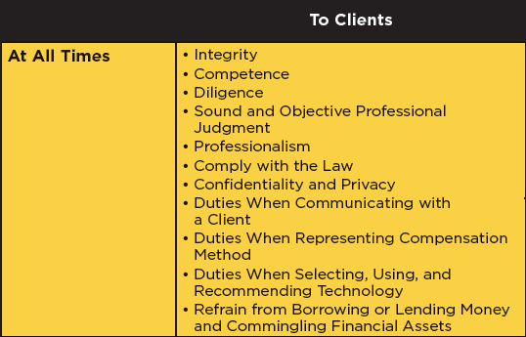
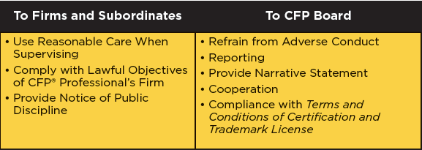
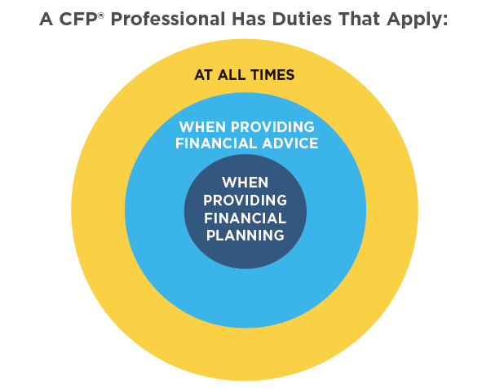
CFP Board’s Code of Ethics and Standards of Conduct reflects the commitment that all CFP® professionals make to high standards of competency and ethics.
Duties of a CFP® Professional
Notes:
The Code and Standards sets forth duties that a CFP® professional has to the client, the firm and subordinates, and CFP Board. Most of these duties apply at all times. Additional duties apply as the work of the CFP® professional increases. For example, a CFP® professional also has a fiduciary duty that applies when providing Financial Advice to a Client.

Slide 16
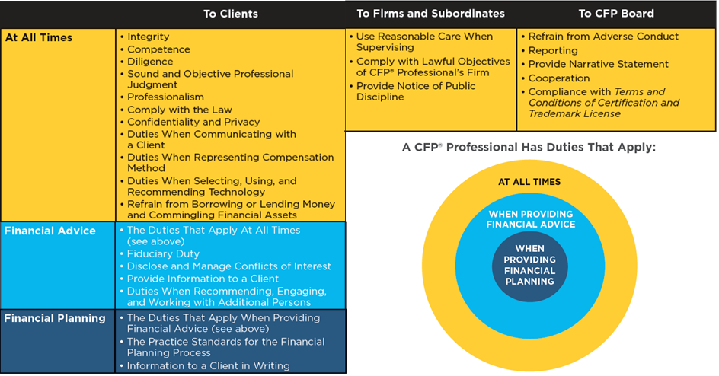
Duties of a CFP® Professional: To Clients
Notes:
Integrity (Standard A.2.): A CFP® professional must perform professional services with integrity. Integrity demands honesty and candor, which may not be subordinated to personal gain or advantage. The standard also contains the standard anti-fraud language that exists in law and regulation, the interpretations of which will guide interpretation of this standard.
Key points:
Honesty and candor that is not subordinated to personal gain or advantage
Standard anti-fraud language
Competence (Standard A.3.): A CFP® professional must provide Professional Services with competence, which means with relevant knowledge and skill to apply that knowledge. When the CFP® professional is not sufficiently competent in a particular area to provide the Professional Services, the CFP® professional must gain competence, obtain the assistance of a competent professional, limit or terminate the Engagement, and/or refer the Client to a competent professional. A CFP® professional is required to describe to the Client any requested Professional Services that the CFP® professional will not be providing.
Key Points:
Relevant knowledge and skill
Gain competence, obtain assistance, limit or terminate engagement, and/or refer the Client
Diligence (Standard A.4.): A CFP® professional must provide Professional Services, including responding to reasonable Client inquiries, in a timely and thorough manner.
Key Points:
Timely and thorough
Sound and Objective Professional Judgment (Standard A.6.): When exercising professional judgment, a CFP® professional must act objectively to serve the interests of Clients, rather than themselves, their firms, or anyone else. CFP® professionals may not solicit or accept any gift, gratuity, entertainment, non-cash compensation, or other consideration that could reasonably be expected to compromise their objectivity. CFP Board opted for a principles-based standard, rather than setting specific dollar amount limits.
Key Points:
Exercise professional judgment that is not subordinated.
Avoid considerations that could compromise objectivity.
Professionalism (Standard A.7.): Unlike many of the other “duties” on this list, the duty to act with Professionalism applies not just to Clients, but also to prospective Clients, fellow professionals, and others. It requires CFP® professionals to treat others with dignity, courtesy, and respect.
Key Points:
Treat Clients and others with dignity, courtesy, and respect.
Duties When Communicating with a Client (Standard A.11.): A CFP® professional must provide a Client with accurate information in a manner and format that a Client reasonably could be expected to understand. The information must be provided in accordance with the terms of the Engagement (the oral or written agreement, arrangement, or understanding between the CFP® professional and the Client) and in response to reasonable Client requests.
Key Points:
Provide accurate information in an understandable manner and format.
Comply With the Law (Standard A.8.): The Code and Standards also requires a CFP® professional to comply with the laws, rules, and regulations governing Professional Services, and prohibits a CFP® professional from intentionally or recklessly participating or assisting another person’s violation of these Standards or the laws, rules, or regulations governing Professional Services.
Confidentiality/Privacy (Standard A.9.):
A CFP® professional is required to keep confidential and protect the security of personal non-public information about Clients. The Code and Standards sets forth the circumstances when confidential information may be disclosed for ordinary business purposes or for legal and enforcement purposes. A CFP® professional also may not use the information for his or her personal benefit, whether or not it causes detriment to the Client, without the Client’s consent. A CFP® professional, either directly or through the firm, must take reasonable steps to protect the security of the information, and adopt policies governing the handling or sharing of the information. A CFP® professional must provide written notice of policies at the time of Engagement. There is a safe harbor for when a CFP® Professional’s Firm is subject to, and the CFP® professional complies with, Reg S-P or substantially equivalent federal or state laws or rules.
Key Points:
Applies to non-public personal information (NPPI)
Exceptions for ordinary business (four) and legal/enforcement (seven)
Can’t benefit from NPPI
Must protect security and adopt, implement, and provide written notice of policies
Safe Harbor for Reg S-P (or equivalent)
Technology (Standard A.14.): CFP Board’s revised Code and Standards impose a principles-based duty that recognizes the important role that technology now plays in the delivery of Professional Services. CFP® professionals now have a “Duty to Use Reasonable Care When Selecting, Using, and Recommending Technology.” When selecting, using, or recommending any software, digital advice tool, or other technology to provide Professional Services to Clients, it is not enough to simply rely on the technology. CFP® professionals are required to act reasonably in selecting, using, and recommending the technology, understand its assumptions and outcomes, and have a reasonable basis for believing it will produce reliable, objective, and appropriate results.
Key Points:
Use reasonable care in selecting, using and recommending
Have a reasonable understanding of assumptions and outcomes
Have a reasonable basis for believing outcomes will be reliable, objective, and appropriate
Borrowing, Lending, and Commingling (Standard A.15.): CFP Board modified, but largely retained, the standards on borrowing from or lending to a Client, and commingling. Borrowing and lending is allowed if the Client is a Family member or if the lender is an organization or entity in the business of lending money. The most significant change is that the standard now explicitly prohibits indirect borrowing. Commingling of Financial Assets is prohibited.
Key Points:
Refrain from Borrowing, Lending, and Commingling Financial Assets

Slide 17
l.o.1: REQUIRED Exercise 1
The video below is found in the Compliance Resources.
Play the following video:
Understanding the Term "Fee Based”
https://www.cfp.net/ethics/compliance-resources/2019/02/understanding-the-term-fee-based
Time 1:28 (min:sec)
4

Slide 18
Duties: Representing Compensation
Are you Fee Only?
Notes:
Representation of Compensation Method (Standard A.12.): The focus here is on accurate representations. The new definition of fee-only is consistent with CFP Board’s long-standing interpretation. The Code and Standards defines the term fee-only by exclusion, and addresses whose compensation the standard will consider for this purpose. A CFP® professional may describe his or her or the Firm’s compensation method as fee-only only where: (1) the CFP® professional and the CFP® Professional’s Firm receives no Sales-Related Compensation; and (2) Related Parties receive no Sales-Related Compensation in connection with any Professional Services the CFP® professional or the CFP® Professional’s Firm provides to Clients. Sales-Related Compensation is a new term. The more commonly-used term is commissions. Sales-Related Compensation is used because there are some fees that present an incentive for the purchase or sale of particular Financial Assets, such as a 12(b)1 fee. So, while someone who is fee-only only accepts fees, there are some fees that a fee-only planner may not accept. The definition of “Sales-Related Compensation” also includes referral compensation. There are several examples of what constitutes “Sales-Related Compensation.” Five things are explicitly excluded. These exclusions are found in Section A.12.a.iii
Compensation to Related Parties also is considered, but only if that compensation is received in connection with any Professional Services the CFP® professional or the CFP® Professional’s Firm provides to Clients.
There is also a new standard for “fee-based” and other similar terms. “Fee-based” is equivalent to “commission and fee.” A CFP® professional who represents his or her compensation method as fee-based must not suggest the CFP® professional or the CFP® Professional’s Firm is fee-only, and must clearly state either that the CFP® professional earns both fees and commissions, or is not fee-only.
If your Firm makes compensation representations that are inconsistent with CFP Board’s Code and Standards, and you do not control the firm, then you must correct any misrepresentation by accurately representing your compensation method to your clients.
Are you fee-only?
First, figure out whether YOU are earning Sales-Related Compensation. If so, then you aren’t fee-only. Second, determine what will be considered your firm. A CFP® Professional’s Firm is “any entity on behalf of which a CFP® professional provides Professional Services to a Client, and that has the authority to exercise control over the CFP® professional’s activities, including the CFP® professional’s employer, broker-dealer, registered investment adviser, insurance company, and insurance agency.” You may have more than one firm that qualifies as a “CFP® professional’s firm.” Is your firm earning Sales-Related Compensation? If so, then you aren’t fee-only.
Next, determine who is a Related Party. A Related Party is a “person or business entity (including a trust) whose receipt of Sales-Related Compensation a reasonable CFP® professional would view as benefiting the CFP® professional or the CFP® Professional’s Firm, including, for example, as a result of the CFP® professional’s ownership stake in the business entity.” Family members and controlled business entities are presumed to be Related Parties. Are your Related Parties earning “Sales-Related Compensation”? If so, is it in connection with any Professional Services you or your Firm provides to Clients? A connection exists when the compensation results, directly or indirectly, from Client transactions referred (or facilitated) by the CFP® professional or the CFP® Professional’s Firm. If your Related Party earns Sales-Related Compensation that is in connection with, you cannot use fee-only. There is a safe harbor to avoid compensation being “in connection with” if you (or your firm) adopt and implement reasonable policies and procedures designed to prevent recommendations to the Related Party.

Slide 19
l.o.1: REQUIRED EXERCISE 2
REQUIRED: Please present and instruct on the following case study:
Case Study | Compliance Resources Link Location
A CFP® PROFESSIONAL FIRM’S SALES-RELATED COMPENSATION | https://www.cfp.net/ethics/compliance-resources/2019/11/a-cfp-professional-firms-sales-related-compensation
4

Slide 20
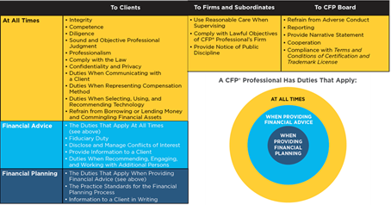
Duties: Working With Additional Persons
Notes:
Duties When Recommending, Engaging, and Working with Additional Persons (Standard A.13.): This is a new standard that sets forth requirements for CFP® professionals who recommend, engage, and work with additional persons. Because CFP® professionals often work with additional persons, CFP Board identified the need for a standard.
When engaging or recommending another professional, a CFP® professional must:
1. Have a reasonable basis for the recommendation or Engagement based on the other professional’s reputation, experience, and qualifications; and
2. Disclose any arrangement by which someone other than the client will compensate the CFP® professional, the CFP® Professional’s Firm, or a Related Party for the Engagement or recommendation.
For Engagements, the CFP® professional must take reasonable steps to protect the Client’s interests.
When working with another professional on a Client’s behalf, the CFP® professional must:
1. Communicate with the other professional about the services each will provide and their respective responsibilities; and
2. Timely inform the Client if the other professional did not perform the services in accordance with the scope of services to be provided and the allocation of responsibilities.
Key Points:
Duties When Engaging or Recommending
Develop a reasonable basis
Disclose compensation arrangements
Duties When Engaging
Exercise reasonable care
Duties When Working With Additional Persons
Communicate about services and responsibilities
Inform client if the other provider did not perform or uphold responsibilities

Slide 21
Details of significant changes
Learning objectives 2 to 4
Notes:
Module 2: Learning Objective 2

Slide 22
describe CFP Board’s Fiduciary Duty
LEARNING OBJECTIVE 2
Notes:
Learning Objective 2
Since all CFP® professionals will be required to act as fiduciaries more frequently than in the past, it is important that you learn the actions required.

Slide 23
l.o.2: REQUIRED Exercise 1
The video below are found in the Compliance Resources.
Play the following video:
THE FIDUCIARY OBLIGATION
https://www.cfp.net/ethics/compliance-resources/2018/12/the-fiduciary-obligation
Time 1:50 (min:sec)
4

Slide 24
Fiduciary Duty
The cornerstone of the Code and Standards is the Fiduciary Duty. At all times when providing Financial Advice to a Client, a CFP® professional must act as a fiduciary and, therefore, act in the best interests of the Client.
What does it mean to act as a fiduciary and, therefore, act in the best interests of the Client? A CFP® professional must fulfill the following duties:
FIDUCIARY DUTY
Duty of Loyalty
+
Duty of Care
+
Duty to Follow Client Instructions
=
4
Notes:
Fiduciary Duty (Standard A.1.): A fiduciary is required to act in the best interest of the Client. The Standards previously imposed a fiduciary duty whenever a CFP® professional was providing financial planning or material elements of financial planning to a client. The revised Code and Standards imposes a fiduciary duty at all times when a CFP® professional is providing Financial Advice to a Client. Financial Advice is broadly defined. CFP Board’s new Fiduciary standard matches traditional fiduciary law.
Duty of Loyalty (Standard A.1.a.): In a relationship of trust, the Client seeks advice from a fiduciary. The law requires the fiduciary to respond with loyalty and devotion. The fiduciary must act to benefit the Client, not benefit himself or herself.
A CFP® professional must place the Client’s interest ahead of the CFP® professional’s, the CFP® Professional’s Firm, and any individual or entity other than the Client. There will be times when a CFP® professional’s interests conflict with the Client’s interests. When material conflicts are not avoided, they must be fully disclosed to the Client, the Client must provide informed consent, and the CFP® professional must “properly manage” the conflict. The Duty of Loyalty also requires CFP® professionals who work under a conflict to continue to act in the best interests of their Client after the conflict has been disclosed, without regard to the interests of others.
Duty of Care (Standard A.1.b.): The Duty of Care requires a CFP® professional to act with the care, skill, prudence, and diligence of a prudent professional. This takes into account the Client’s goals, risk tolerances, objectives, and financial and personal circumstances.
Duty to Follow Client Instructions (Standard A.1.c.): The Duty to Follow Client Instructions recognizes that a CFP® is an agent of the Client, and is required to carry out the terms of the Engagement, as well as all reasonable and lawful Client requests. If the CFP® professional does not believe that what the Client wants is in the Client’s best interests, the CFP® professional must so advise the Client. But ultimately, the Client gets to decide what to do.

Slide 25
l.o.2: REQUIRED EXERCISE 2
REQUIRED: Please present and instruct on the following case study:
Case Study | Compliance Resources Link Location
Apply the Fiduciary Duty to Client Instructions that Conflict with the Duty of Care | https://www.cfp.net/ethics/compliance-resources/2019/11/applying-the-fiduciary-duty-to-client-instructions-that-conflict-with-the-duty-of-care
4

Slide 26
l.o.2: REQUIRED EXERCISE 3
REQUIRED: Please present and instruct on the following case study:
Case Study | Compliance Resources Link Location
The Duty to Follow a Client's Instruction to Use a Specific Firm for Execution | https://www.cfp.net/ethics/compliance-resources/2019/10/the-duty-to-follow-a-clients-instruction-to-use-a-specific-firm-for-execution
4

Slide 27
l.o.2: REQUIRED EXERCISE 4
REQUIRED: Please present and instruct on the following case study:
Case Study | Compliance Resources Link Location
The Fiduciary Duty and an A Share Class Recommendation | https://www.cfp.net/ethics/compliance-resources/2019/11/the-fiduciary-duty-and-an-a-share-class-recommendation
4

Slide 28
Identify Material Conflicts of Interest and How to Avoid, or Fully Disclose, Obtain Informed Consent, and Manage Them.
LEARNING OBJECTIVE 3
Notes:
A CFP® professional must be able to recognize and either avoid or disclose, obtain informed consent, and manage Material Conflicts of Interest.

Slide 29
Conflicts of Interest
A CFP® professional must avoid or disclose, obtain informed consent and manage material conflicts of interest.
Material:
When a reasonable Client or prospective Client would consider the Conflict of Interest important in making a decision
A “Conflict of Interest” arises when:
A CFP® professional’s interests (including the interests of the CFP® Professional’s Firm) are adverse to the CFP® professional’s duties to a Client; or
A CFP® professional has duties to one Client that are adverse to another Client.
Notes:
This requirement is addressed more fully in Standard A5, which requires a CFP® professional who is providing Financial Advice to make full disclosure of all Material Conflicts of Interest that could affect the professional relationship with a Client and provide sufficiently specific facts so that the Client is able to understand the conflicts and the business practices that give rise to the conflicts and give informed consent to such conflicts or reject them. (slide and notes source: https://www.cfp.net/ethics/compliance-resources/2018/08/focus-on-ethics---avoiding-or-managing-and-disclosing-conflicts-of-interest

Slide 30
Examples of Conflicts of Interest
Compensation and Incentives
Acting for Multiple Clients
401k Rollover
Affiliate Products
Higher commission
Notes:
Compensation is always a conflict that must be disclosed to the Client. The last two examples come from Case Studies that might be used later in the presentation.

Slide 31
l.o.3: REQUIRED EXERCISE 1
REQUIRED: Please present and instruct the following case study:
Case Study | Compliance Resources Location
The Duty to Disclose and Manage Material Conflicts of Interest Involving Proprietary Products | https://www.cfp.net/ethics/compliance-resources/2019/11/the-duty-to-disclose-and-manage-material-conflicts-of-interest-involving-proprietary-products
4

Slide 32
l.o.3: REQUIRED EXERCISE 2
REQUIRED: Please present and instruct the following case study:
Case Study | Compliance Resources Location
THE DUTY TO DISCLOSE MATERIAL CONFLICTS OF INTEREST WHEN RECOMMENDING A PRODUCT ISSUED BY AN AFFILIATE | https://www.cfp.net/ethics/compliance-resources/2019/10/the-duty-to-disclose-material-conflicts-of-interest-when-recommending-a-product-issued
4

Slide 33
l.o.3: REQUIRED EXERCISE 3
REQUIRED: Please present and instruct the following case study:
Case Study | Compliance Resources Location
THE DUTY TO DISCLOSE MATERIAL CONFLICTS OF INTEREST WHEN RESPONDING TO A CLIENT'S INVESTMENT INQUIRY | https://www.cfp.net/ethics/compliance-resources/2019/10/the-duty-to-disclose-material-conflicts-of-interest-when-responding-to-a-clients-investment-inquiry
4

Slide 34
l.o.3: REQUIRED EXERCISE 4
REQUIRED: Please present and instruct the following case study:
Case Study | Compliance Resources Location
THE DUTY TO DISCLOSE MATERIAL CONFLICTS OF INTEREST WHEN MAKING A ROLLOVER RECOMMENDATION | https://www.cfp.net/ethics/compliance-resources/2019/10/the-duty-to-disclose-material-conflicts-of-interest-when-making-a-rollover-recommendation
4

Slide 35
How to Handle Conflicts of Interest
For Material Conflicts that are not avoided:
Provide Full Disclosure;
Obtain Client’s Informed Consent; and
Properly Manage the Conflict.
Notes:
Disclose and Manage Conflicts of Interest (Standard A.5.): The revised Code and Standards sets forth several requirements concerning Conflicts of Interest. A CFP® professional must:
Avoid Material Conflicts of Interest by providing sufficiently specific facts
Obtain informed consent, and manage

Slide 36
Full Disclosure and Informed Consent
Disclose “Sufficiently Specific Facts”
Would a reasonable Client understand the conflict and how it could affect the advice?
Ambiguity interpreted in favor of the Client
Delivery
Written disclosure is not required
Oral disclosure weighed as CFP Board deems appropriate
Obtain Informed Consent
Written consent is not required
When will consent be inferred?
Material Conflict of Interest
Informed Consent
Disclose
Notes:
Disclose Conflicts (Standard A.5.a.): The obligation in the revised Code and Standards requires a CFP® professional to provide the Client with sufficiently specific facts so that a reasonable Client is able to understand the CFP® professional’s Conflicts of Interest and the business practices that give rise to the conflicts, and give informed consent to such conflicts or reject them. A sincere belief by a CFP® professional with a Material Conflict of Interest that he or she is acting in the best interests of the Client is insufficient to excuse failure to make full disclosure.
A CFP® professional must make full disclosure and obtain the consent of the Client before providing any Financial Advice regarding which the CFP® professional has a Material Conflict of Interest
In determining whether the disclosure of a Material Conflict of Interest provided to the Client was sufficient to infer that a Client has consented to a Material Conflict of Interest, CFP Board will evaluate whether a reasonable Client receiving the disclosure would have understood the conflict and how it could affect the advice the Client will receive from the CFP® professional. The greater the potential harm the conflict presents to the Client, and the more significantly a business practice that gives rise to the conflict departs from commonly-accepted practices among CFP® professionals, the less likely it is that CFP Board will infer informed consent absent clear evidence otherwise. Ambiguity in the disclosure provided to the Client will be interpreted in favor of the Client.
Evidence of oral disclosure of a conflict will be given such weight as CFP Board in its judgment deems appropriate. As a best practice, CFP Board recommends that a CFP® professional disclose the Conflict of Interest in writing before or when providing the Financial Advice. Written consent to a conflict is not required.
Whether a Client has provided informed consent depends on the facts and circumstances and may be inferred when not explicit. For example, silence after disclosure may constitute informed consent if the disclosure contains sufficiently specific facts that are understandable to a reasonable Client, but may not constitute informed consent if that is not the case.

Slide 37
Must Also Manage Conflicts
Management of Conflicts
Must adopt and follow business practices reasonably designed to prevent Material Conflicts from compromising the CFP® professional’s ability to act in the Client’s best interests
Material Conflict of Interest
Informed Consent
Disclose
Manage
Notes:
Manage Conflicts (Standard A.5.b.): The management of Conflicts of Interest requires a CFP® professional to adopt and follow business practices reasonably designed to prevent Material Conflicts from compromising the CFP® professional’s ability to act in the Client’s best interests. This means that mere disclosure of conflicts is not enough. The Conflicts of Interest must be managed in the Client’s best interests.
For example, in the case of a compensation conflict, the CFP® professional must take steps to ensure that recommendations are based on the Client’s goals, risk tolerance, objectives, and financial and personal circumstances, and not his/her potential compensation.

Slide 38
Understand the Duty to Report to CFP Board and the Duty to Cooperate.
LEARNING OBJECTIVE 4

Slide 39
Importance
The Duty to Report and the Duty to Cooperate are key elements of an enforcement program that seeks to detect potential misconduct. A significant component of the value of CFP® certification is derived from the fact that CFP Board enforces the Code and Standards.
A CFP® professional’s failure to report the required information to CFP Board constitutes a violation of the Code and Standards, even if the matter that the CFP® professional was required to report does not reveal misconduct.
Effective January 2024, the sanction guideline for a violation of the Duty to Report will be a public censure.
Notes:
The Duty to Report and the Duty to Cooperate are key elements of an enforcement program that seeks to detect potential misconduct and uphold the high standards of competency and ethics set forth in the Code and Standards. Not every reportable matter will result in an investigation or a finding that a CFP® professional has violated the Code and Standards. However, a CFP® professional’s failure to report the required information to CFP Board constitutes a violation of the Code and Standards, even if the matter that the CFP® professional was required to report does not reveal misconduct. Effective January 2024, the sanction guideline for a violation of the Duty to Report is a public censure. A failure to comply with the Duty to Cooperate also constitutes a violation of the Code and Standards and may give rise to an adverse inference against the CFP® professional in an enforcement proceeding that presumes the CFP® professional would have provided the documents or information if they were not unfavorable to the CFP® professional.

Slide 40
Duty to Report
Applies at the initiation and the conclusion of the reportable matter.
The information must be reported within 30 days.
Must include a narrative statement that describes the material facts and the outcome or status of the reportable matter.
Online reporting form that is located at CFP.net/ethics/reporting.
Contact CFP Board if you have questions. You may seek guidance on the Duty to Report at compliance@cfpboard.org.
Notes:
The Duty to Report information to CFP Board applies both to the initiation and the conclusion of the reportable matter that concerns a CFP® professional’s conduct, as set forth below. A CFP® professional must provide written notice to CFP Board within thirty (30) calendar days of both the initiation and conclusion of the reportable matter, and include a narrative statement that accurately and completely describes the material facts and the outcome or status of the reportable matter. CFP Board has established an online reporting form that is located at CFP.net/ethics/reporting, at which the user will be directed to the relevant reporting page within his or her online account. Thereafter, a CFP® professional also must complete the CFP Board Ethics Declaration when renewing his or her certification, although once a matter required to be reported is reported, it is not necessary to report it again. A CFP® professional may seek guidance on the Duty to Report by contacting compliance@cfpboard.org.
(Following is information that may be used if a participant asks a question about reporting information on Form U4 (Uniform Application for Securities Industry Registration or Transfer). When CFP Board announced that, effective January 2024, the sanction guideline for a failure to timely report information would be a public censure, CFP Board also stated that timely reporting on Form U4 is equivalent to timely reporting to CFP Board. (See https://www.cfp.net/news/2021/11/cfp-board-increases-sanction-for-self-reporting-failures-requests-comments-on-proposed.) The result is that if an event is timely reported on a Form U4, then it does not also need to be reported to CFP Board. This is a “safe harbor” that exists only for the information that is reported on Form U4. A CFP® Professional who states that he or she timely reported the information on Form U4 may be asked to provide a copy of the Form U4 showing that the information was timely reported on the Form U4. While CFP Board does not provide guidance for CFP® professionals on the requirements for reporting on a Form U4, CFP Board will provide guidance on the requirements for reporting to CFP Board. Those who have questions may email them to compliance@cfpboard.org.)

Slide 41
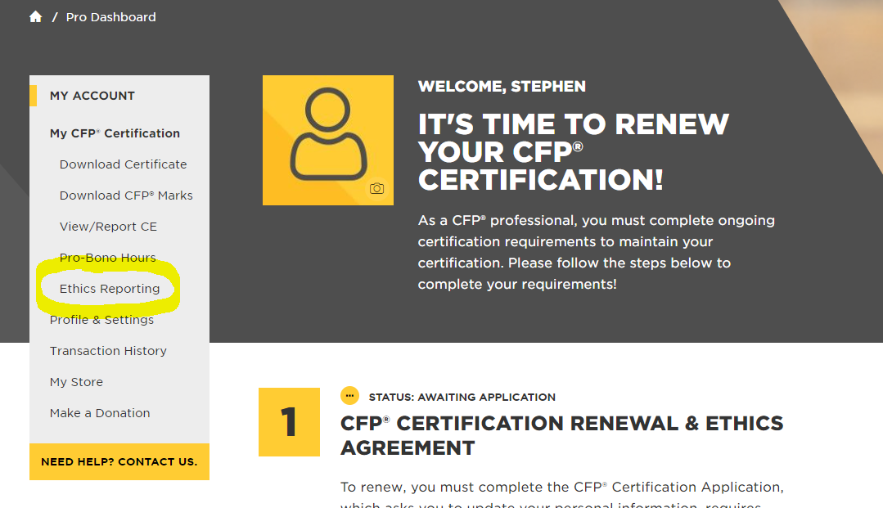
Self reporting
Easily accessible from Dashboard
Always available
Reports stored in permanent record
Notes:
Once a CFP® professional has accessed his or her account to make a report, he or she will navigate to the tab that is titled Ethics Reporting. This tab is accessible through the dashboard shown here. Once a CFP® professional submits a report, the information is stored permanently within that user’s account. The user can access prior reports but cannot change a report once it has been submitted.

Slide 42
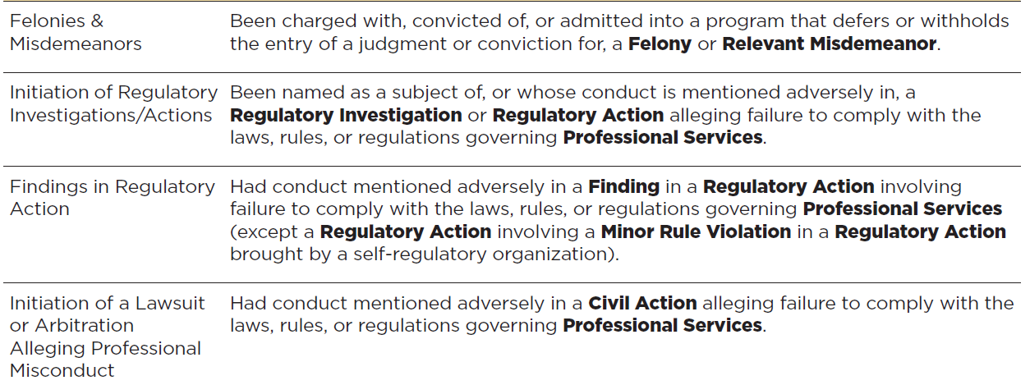
You Are Required to Report:
Notes:
Questions on the Ethics Declaration form are designed to address each of the required reporting categories. Definitions for certain terms, which are bolded here and italicized within the Ethics Declaration form, are available by hovering over the defined term within the form. Any questions about these terms may be raised by emailing compliance@cfpboard.org.
The first category is criminal conduct, Felonies and Misdemeanors. A CFP® professional is required to report whenever the CFP® professional is charged with a felony or Relevant Misdemeanors and also when the CFP® professional is convicted of (or entered into a deferred adjudication program for) a felony or Relevant Misdemeanor. The definition of Relevant Misdemeanor includes misdemeanor offenses involving fraud, theft, misrepresentation, other dishonest conduct, crimes of moral turpitude, violence, or a second (or more) alcohol or drug-related offense. A single event that results in charges or conviction of a drug or alcohol offense need not be reported to CFP Board, but a second event (regardless of whether the first event resulted in a conviction) must be reported to CFP Board. For example, if a CFP® professional, who has never been charged with any crime before, is arrested and charged with Driving Under the Influence, and those charges are dismissed, then so long as that event was charged as a misdemeanor (and not a felony), then the CFP® professional does not need to report that event to CFP Board. But if that person is charged with misdemeanor possession at a later date, then the second event must be reported to CFP Board.
The second category is Initiation of Regulatory Investigations and Action. This information is reportable to CFP Board if the CFP® professional is the subject of an enforcement action by a regulator AND if he or she is the subject of an investigation. As a result, such a person should report to CFP Board if he or she receives a request for information or a subpoena from a regulator or is asked to provide testimony as part of an investigation. In this context, regulators often include the SEC, FINRA, and state securities or insurance regulators. For some professionals, regulators also may include a state Board of Accountancy, a state bar, a banking regulator, or another federal or state regulatory authority.
In the third category, conduct that is the subject of a regulatory action is reportable. Note that the exception for a Minor Rule Violation rarely arises.
In the fourth category, any civil action, regardless of whether it’s a lawsuit filed in a court or an arbitration, must be reported to CFP Board if it relates to a CFP professional’s conduct in connection with Professional Services. This is true regardless of whether the CFP® professional is named as a defendant or respondent in the civil action.

Slide 43
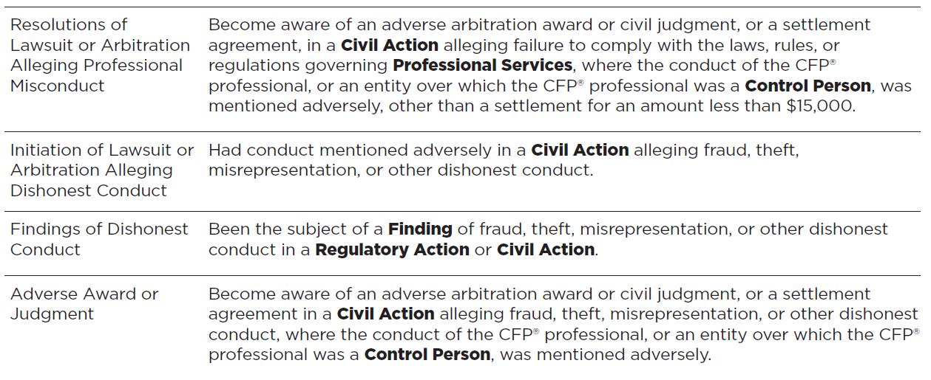
You Are Required to Report
Notes:
Similar to the last category on the previous slide, the first category here involves resolutions of a lawsuit or arbitration alleging professional misconduct. This requires an update of the report that the CFP® professional was required to make when the lawsuit was filed. In addition, this requirement also includes resolutions involving lawsuits involving entities of which the CFP® professional is a control person. For control person questions, please be aware of disclosures made in regulatory filings. For example, if a firm’s Form ADV identifies a CFP® professional as a control person, then CFP Board will expect that CFP® professional to report relevant conduct related to that entity.
The three remaining categories on this slide, Initiation of Lawsuit or Arbitration Alleging Dishonest Conduct, Findings of Dishonest Conduct, and Adverse Award or Judgment, each cover conduct that extends beyond the context of professional services. Any lawsuit or arbitration in which the CFP® professional is alleged to have engaged in any of the listed conduct must be reported to CFP Board both at the initiation of the matter and at its resolution.

Slide 44
You Are Required to Report
Notes:
The first category on this slide, Adverse Impact on License, Certification or Membership, addresses any action taken in those categories. This includes financial services licenses and any other professional licenses that may be applicable to a CFP® professional, be it a law license, a medical license, CPA license or any other license. It also includes voluntary certifications or memberships, such CFA certification, or other certifications and memberships. If the licensing agency or credentialing organization takes an action to suspend, revoke or materially restrict activities pursuant to that license, certification, or membership, then that event must be reported to CFP Board.
The second category, Termination, relates to employment separations. Regardless of whether the separation is a termination or if the professional is permitted to resign, the event is reportable if the basis for the separation is an allegation of dishonesty, unethical conduct, or compliance failures.
The third category, Customer Complaint, covers instances where a customer of the CFP® professional complains about the services he or she received. Any customer complaint that meets any of the three categories listed here must be reported to CFP Board.

Slide 45
You Are Required to Report
Notes:
CFP Board requires reporting of certain events that raise questions about management of personal finances.
First is Bankruptcy. If a CFP® professional or a business of which such a person is a control person files a petition in bankruptcy, then he or she must report that filing. Please note that it is the filing of the bankruptcy that is reportable, regardless of whether that process results in a discharge or is dismissed or abandoned. The report must be made within 30 days of filing the bankruptcy petition, even if that petition is already withdrawn.
Next is Federal Tax Lien. If a CFP® professional is the subject of a federal tax lien, then he or she must report that filing, regardless of the status of that lien.
And finally, if a CFP® professional is the subject of a state or local lien or any civil judgment not reportable in any other category, the he or she must report it if such lien or judgment is not satisfied within a year of the date of its entry.

Slide 46
Duty to Cooperate
The Code and Standards (Standard E.5.) also expands upon a CFP® professional’s Duty to Cooperate.
A CFP® professional may not make false or misleading representations to CFP Board or obstruct CFP Board in the performance of its duties.
A CFP® professional also must cooperate fully with CFP Board’s requests, investigations, disciplinary proceedings, and disciplinary decisions.
As described more fully in CFP Board’s Procedural Rules (Article 1.3), cooperation includes providing documents and information, admitting or denying facts, appearing for oral examination, and using reasonable efforts to obtain documents, information, and witness appearances from third parties.
Notes:
The Code and Standards (Standard E.5.) also expands upon a CFP® professional’s Duty to Cooperate. A CFP® professional may not make false or misleading representations to CFP Board or obstruct CFP Board in the performance of its duties. A CFP® professional also must cooperate fully with CFP Board’s requests, investigations, disciplinary proceedings, and disciplinary decisions. As described more fully in CFP Board’s Procedural Rules (Article 1.3), cooperation includes providing documents and information, admitting or denying facts, appearing for oral examination, and using reasonable efforts to obtain documents, information, and witness appearances from third parties.
The CFP® professional must provide a narrative statement regarding the underlying reportable event. The CFP® professional must provide the facts that gave rise to the event, the current status of the event and any and all documents regarding the substance of the event.

Slide 47
l.o.4: REQUIRED EXERCISE
REQUIRED: Please open the document, identify the different sections, and identify the different categories listed in the document.
Document | Compliance Resources Location
DUTY TO REPORT INFORMATION TO CFP BOARD AND DUTY TO COOPERATE WITH CFP BOARD INVESTIGATIONS | Page Link: https://www.cfp.net/ethics/compliance-resources/2020/06/duty-to-report-information-to-cfp-board-and-duty-to-cooperate-with-cfp-board-investigations Document PDF Link: https://www.cfp.net/-/media/files/cfp-board/standards-and-ethics/cfp-board-duty-to-report-and-cooperate.pdf
4

Slide 48
Identify the Practice Standards when providing Financial Advice that requires Financial Planning or Financial Planning
LEARNING OBJECTIVE 5

Slide 49
l.o.5: REQUIRED Exercise 1
The video below are found in the Compliance Resources.
Play the following video:
WHAT IS FINANCIAL PLANNING?
https://www.cfp.net/ethics/compliance-resources/2019/05/what-is-financial-planning
Time 1:22
4

Slide 50
Application Of The Practice Standards
The Practice Standards Apply When:
The CFP® professional:
agrees to provide or provides Financial Planning
agrees to provide or provides Financial Advice that requires integration of relevant elements to act in Client’s best interests
The Client has a reasonable basis to believe the CFP® professional will provide or has provided Financial Planning
Notes:
The Practice Standards Apply When:
The CFP® professional agrees to provide or provides Financial Planning
The CFP® professional agrees to provide or provides Financial Advice that requires integration of relevant elements to act in Client’s best interests
The Client has a reasonable basis to believe the CFP® professional will provide or has provided Financial Planning
Application of Practice Standards (Standard B.3.): CFP Board has redefined when a CFP® professional must comply with the Practice Standards. There are two major changes:
1. Under the previous standard, the Client’s subjective understanding and intent in engaging the CFP® professional was one relevant factor in determining whether Financial Planning was required. The revised Code and Standards adopt an objective standard that is sufficient, on its own if satisfied, to require Financial Planning. If the Client has no reasonable basis for believing that the CFP® professional will provide or has provided Financial Planning, the Client’s understanding and intent in engaging the CFP® professional is not relevant.
2. The revised Code and Standards provides that the Financial Advice you agree to provide to a Client may require you to provide Financial Planning to act in the Client’s best interests.
CFP Board Evaluation (Standard B.5.): When CFP Board alleges that a CFP® professional was required to provide Financial Planning, the CFP® professional must demonstrate that he or she was not required to comply with the Practice Standards. This standard thus functions as an evidentiary presumption that arises solely in the enforcement context. Since it will be your burden to show that Financial Planning was not required, you should consider documenting or maintaining evidence of your decision making.
If CFP Board alleges a Practice Standards violation
And the CFP® professional denies the allegations
Then the CFP® professional has the burden of demonstrating that Financial Planning was not required

Slide 51
l.o.5: REQUIRED exercise 2
The video below are found in the Compliance Resources.
Play the following video:
INTEGRATION FACTORS
https://www.cfp.net/ethics/compliance-resources/2019/05/integration-factors
Time 1:32
4

Slide 52
Clients Who Do Not Want Financial Planning
If a CFP® professional otherwise must comply with the Practice Standards, but the Client does not agree to engage for Financial Planning, a CFP® professional must either:
Not enter into the Engagement
Limit the scope to services that do not require Financial Planning
Provide the requested service but explain how Financial Planning will benefit the Client and how not providing Financial Planning will limit the Financial Advice
Terminate the Engagement
Notes:
No Client Agreement to Engage for Financial Planning (Standard B.6.): This is a new standard that applies when a CFP® professional is required to comply with the Practice Standards, but the Client does not agree to engage the CFP® professional to provide Financial Planning. This standard reflects the policy judgment that if the Client does not want Financial Planning, it is better to allow the CFP® professional to provide Financial Advice to the Client, instead of requiring the Client to work with someone who has not satisfied CFP Board’s high standards for competence and ethics.
To illustrate how this standard works, let’s assume that a Client seeks Financial Advice on Topics 1, 2, and 3, and that the Financial Advice would require Financial Planning. If the Client refuses to engage the CFP® professional for Financial Planning, the CFP® professional has four options:
1. The CFP® professional may elect not to enter into the Engagement.
2. The CFP® professional may limit the Scope of the Engagement to Financial Advice on Topic 1 if that would not require Financial Planning, and inform the Client that the CFP® professional will not be providing Financial Advice on Topics 2 and 3.
3. The CFP® professional may inform the Client how Financial Planning would benefit the Client and how the decision not to engage the CFP® professional to provide Financial Planning may limit the CFP® professional’s Financial Advice, and provide Financial Advice on Topics 1, 2, and 3 without being required to comply with the Practice Standards.
4. Assuming there is an Engagement, the CFP® professional also may elect to terminate the Engagement.

Slide 53
A Review of the Seven Steps

Slide 54
Documentation
When to Document:
A CFP® professional must act prudently in documenting information, as the facts and circumstances require, taking into account:
The significance of the information;
The need to preserve the information in writing;
The obligation to act in the Client’s best interest; and
The Firm’s policies and procedures.
Acceptable Documentation:
CRM software;
Handwritten notes; or
Emails
WHEN IN DOUBT, DOCUMENT
Notes:
Documentation (Standard C.): A CFP® professional who is required to comply with the Practice Standards must act prudently in documenting information, as the facts and circumstances require, taking into account
the significance of the information,
the need to preserve the information in writing,
the obligation to act in the Client’s best interest, and
the CFP® Professional’s Firm’s policies and procedures.
This is an objective, principles-based standard, the application of which depends on the facts and circumstances. CFP Board elected not to provide specific standards for how a CFP® professional must document the information, or where a CFP® professional must maintain the information, because a CFP® professional may have several options available. For example, it may be enough to write it down in a CRM. The circumstances will dictate what is appropriate.

Slide 55
l.o.5: REQUIRED EXERCISE 3
The guidance below is found in the Compliance Resources.
REQUIRED: Please present and review the content within this video.
Video | Compliance Resources Location
THE FIRST THREE STEPS OF THE FINANCIAL PLANNING PROCESS | https://www.cfp.net/ethics/compliance-resources/2019/08/the-first-three-steps-of-the-financial-planning-process Time: 1:39
Notes:
Step 1 (Standard C.1.): The first step in the revised seven-step Financial Planning process is to understand the Client’s personal and financial circumstances. A CFP® professional satisfies this standard by obtaining qualitative and quantitative information, analyzing the information, and addressing any incomplete information. The standard provides examples of qualitative and quantitative information that a CFP® professional must collaborate with the Client to obtain that captures a myriad of circumstances that might arise. It is not sufficient for the CFP® professional to simply collect data from the Client. The purpose of obtaining data from the Client is to review the information and gain an understanding of the Client’s personal and financial circumstances. It is only by understanding or knowing the Client’s situation that a CFP® professional may collaborate with the Client to develop goals.
Step 2 (Standard C.2.): Once a CFP® professional determines that he or she has gathered the necessary information, the CFP® professional helps the Client identify and select goals. First, the CFP® professional must discuss the CFP® professional’s assessment of the Client’s financial and personal circumstances with the Client. Then – armed with that assessment – the CFP® professional and the Client work together to develop goals. This step envisions that a CFP® professional will discuss scenarios or potential goals with the Client, showing the Client how different decisions impact the likelihood of desired outcomes. The CFP® professional may illustrate the scenarios in real time using software. This collaboration will lead Clients to select more realistic goals and be more engaged in the Financial Planning process. The CFP® professional must show the Client the interrelation of the Client’s goals.
Step 3 (Standard C.3.): The next step is to analyze the Client’s current course of action and potential recommendations. This requirement is new, and reflects the possibility that no adjustments are necessary. A CFP® professional is required to determine whether the current course maximizes the potential for meeting the Client’s goals. Where appropriate, the CFP® professional must analyze one or more potential alternative recommendations. In so doing, the CFP® professional must analyze:
1. The recommendation’s advantages and disadvantages,
2. Whether the recommendation helps maximize the potential for meeting goals, and
3. How the recommendation integrates the relevant elements of the Client’s personal and financial circumstances.

Slide 56
l.o.5: REQUIRED EXERCISE 4
REQUIRED: Please present and instruct the following case study:
Case Study | Compliance Resources Location
INTERPRETING THE PRACTICE STANDARD FOR IDENTIFYING AND SELECTING GOALS | https://www.cfp.net/ethics/compliance-resources/2020/07/case-study-interpreting-the-practice-standard-for-identifying-and-selecting-goals
4

Slide 57
l.o.5: REQUIRED EXERCISE 5
REQUIRED: Please present and review the content within this video.
Video | Compliance Resources Location
THE FOURTH AND FIFTH STEPS OF THE FINANCIAL PLANNING PROCESS | https://www.cfp.net/ethics/compliance-resources/2019/08/the-fourth-and-fifth-steps-of-the-financial-planning-process Time: 1:16
Notes:
Step 4 (Standard C.4.): A CFP® professional then develops the Financial Planning recommendation(s) by selecting, from among the potential courses of action, one or more recommendations designed to maximize the potential for meeting the Client’s goals. For each recommendation, the CFP® professional must consider the assumptions and estimates, the basis for making the recommendation (including specific factors set forth in the standard), the timing and priority of the recommendation, and whether the recommendation is independent or must be implemented with one or more other recommendations. The rationale for making the recommendation provides substantial detail on what you must consider for the recommendation:
How the recommendation is designed to maximize the potential to meet the Client’s goals,
The anticipated material effects of the recommendation on the Client’s financial and personal circumstances, and
How the recommendation integrates relevant elements of the Client’s personal and financial circumstances (this requires a CFP® professional to look at how the recommendation takes into account other aspects of the Client’s life).
Step 5 (Standard C.5.): The next step requires the CFP® professional to present to the Client the recommendation(s) and the information that was required to be considered when developing the recommendation(s). This does not always require a written plan. Rather, CFP® professionals must exercise professional judgment in determining how best to present recommendations to Clients.
It is notable that presenting the recommendation is its own step, separate from developing the recommendation(s). This reflects that developing and presenting the recommendation(s) are operationally distinct actions. A CFP® professional will select the recommendation(s) prior to meeting with and making a presentation to the Client. This step of the process involves analysis and development of the rationale. The presentation step of the process is Client-facing and involves explaining to the Client the recommendation(s) and the basis for the recommendation(s).

Slide 58
l.o.5: REQUIRED EXERCISE 6
REQUIRED: Please present and review the content within this video.
Video | Compliance Resources Location
THE SIXTH AND SEVENTH STEPS OF THE FINANCIAL PLANNING PROCESS | https://www.cfp.net/ethics/compliance-resources/2019/09/the-sixth-and-seventh-steps-of-the-financial-planning-process Time: 2:30
Notes:
Step 6 (Standard C.6.): The new implementation step is more comprehensive. A CFP® professional must communicate with the Client the recommendation(s) being implemented and specify who will be responsible for implementation. A CFP® professional with implementation responsibilities must identify and analyze actions, products or services that are designed to implement the recommendation(s), determining how it does so, and what are its advantages and disadvantages compared to alternatives. Once the CFP® professional has arrived at implementation recommendations, he or she must make the recommendations. The CFP® professional must communicate to the Client:
1. The basis for selecting an action, product, or service,
2. The timing and priority of implementing the action, product, or service, and
3. Any Material Conflicts of Interest concerning the action, product, or service.
Finally, a CFP® professional must help the Client implement the recommendation(s). The CFP® professional must discuss with the Client any selection that deviates from the actions, products, and services the CFP® professional recommended. This step is to make the Client aware of any decisions that deviate from the CFP® professional’s advice.
Step 7 (Standard C.7.): Monitoring and updating is a significant step in the seven-step process. For existing Client relationships, monitoring and updating may occur over many years, or even decades. This step requires a CFP® professional to (a) address monitoring and updating responsibilities (including by communicating very specific information to the Client concerning the scope of the respective responsibilities), (b) monitor the Client’s progress, (c) obtain current qualitative and quantitative information, and (d) update goals, recommendations, or implementation decisions. Monitoring progress requires a CFP® professional to analyze, at appropriate intervals, the progress toward achieving the Client’s goals. The CFP® professional must review with the Client the results of the CFP® professional’s analysis.

Slide 59
l.o.5: REQUIRED EXERCISE 7
REQUIRED: Please present and instruct the following case study:
Case Study | Compliance Resources Location
INTERPRETING THE PRACTICE STANDARD FOR IMPLEMENTING THE FINANCIAL PLANNING RECOMMENDATION(S) | https://www.cfp.net/ethics/compliance-resources/2020/07/case-study-interpreting-the-practice-standard-for-implementing-the-financial-planning-recommendation
4

Slide 60
Understand the Duty to Provide Information to Clients When Providing Financial Advice and/or Financial Planning.
LEARNING OBJECTIVE 6

Slide 61
The Financial Advice Framework
AM I PROVIDING FINANCIAL ADVICE TO A CLIENT?
No
Yes
THE FIDUCIARY DUTY DOES NOT APPLY, BUT A CFP® PROFESSIONAL MUST ABIDE BY THE CODE OF ETHICS AND OTHER STANDARDS.
THE FIDUCIARY DUTY APPLIES
DOES THE FINANCIAL ADVICE REQUIRE FINANCIAL PLANNING?
No
Yes
THE FIDUCIARY DUTY APPLIES, BUT A CFP® PROFESSIONAL IS NOT REQUIRED TO APPLY THE PRACTICE STANDARDS FOR THE FINANCIAL PLANNING PROCESS, PROVIDE FINANCIAL PLANNING, OR PROVIDE INFORMATION TO THE CLIENT IN WRITING.
DOES THE CLIENT
AGREE TO ENGAGE FOR
FINANCIAL PLANNING?
Yes
THE FIDUCIARY DUTY APPLIES, AND A CFP® PROFESSIONAL IS REQUIRED TO APPLY THE PRACTICE STANDARDS FOR THE FINANCIAL PLANNING PROCESS, PROVIDE FINANCIAL PLANNING, AND PROVIDE INFORMATION TO THE CLIENT IN WRITING
No
© 2019 Certified Financial Planner Board of Standards, Inc. All Rights Reserved.
Notes:
Definition of Financial Advice (Glossary): The Glossary provides a broad definition of Financial Advice. Financial Advice includes financial plans. It also includes recommendations to invest in, purchase, hold, gift, or sell Financial Assets. It includes recommendations concerning investment strategies, portfolio composition, and asset management. A recommendation to select and retain another professional to provide financial or Professional Services to a Client is Financial Advice. The exercise of "discretion" over a Client’s Financial Assets constitutes “Financial Advice.” CFP Board’s fiduciary duty applies to all of these activities.
The determination of whether Financial Advice has been provided is an objective rather than subjective inquiry. The more individually tailored the communication is to the Client, the more likely the communication will be viewed as Financial Advice. The provision of services or the furnishing or making available of marketing materials, general financial educational materials, or general financial communications that a reasonable CFP® professional would not view as Financial Advice, does not constitute Financial Advice.

Slide 62
Am I Providing Financial Advice?
Notes:
The determination of whether Financial Advice has been provided
is an objective rather than subjective inquiry.
The more individually tailored the communication is to the Client,
the more likely the communication will be viewed as Financial Advice.
Fiduciary Duty (Standard A.1.) and Definitions of Financial Advice and Client (Glossary): The fiduciary duty now applies to all Financial Advice provided to a Client, which is broader than when providing Financial Planning. Who is a Client? A person, including a natural person, business organization, or legal entity, to whom the CFP® professional provides or agrees to provide Professional Services pursuant to an Engagement.

Slide 63
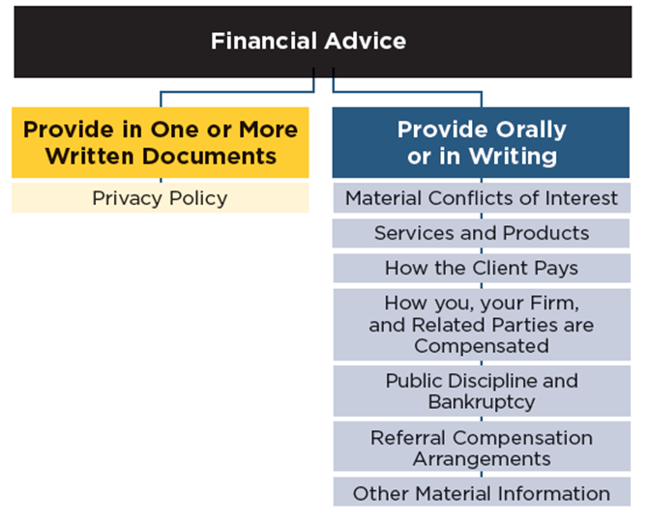
Duty to Provide Information- Financial Advice
Notes:
A CFP® professional has a duty to provide information to a Client. Whether information may be provided orally or must be provided in writing depends upon whether the Financial Advice that is being provided requires Financial Planning.
CFP Board has prepared a Financial Advice Engagements Disclosure Guide and a Financial Planning Engagements Disclosure Guide. The Disclosure Guides describe in detail the Duty to Provide Information to a Client. These flow charts are a brief summary of the categories of information that must be shared with the Client, and whether the information must be provided orally or in writing. The requirement to provide information to a Client set forth in CFP Board’s Code and Standards is in addition to any requirements that apply under applicable law.
Provide Information to a Client (Standard A.10.): The Provide Information to a Client standard sets forth eight specific types of information that must be provided to a Client When providing or agreeing to provide Financial Advice that does not require Financial Planning:
1. A description of the services and products to be provided. (Standard A.10.a.i.)
2. How the Client pays for the products and services, and a description of the additional types of costs that the Client may incur, including product management fees, surrender charges, and sales loads. (Standard A.10.a.ii.)
3. How the CFP® professional, the CFP® Professional’s Firm, and any Related Party are compensated for providing the products and services. (Standard A.10.a.iii.)
4. The existence of any public discipline or bankruptcy and the location(s), if any, of the webpages of all relevant public websites of any governmental authority, self-regulatory organization, or professional organization that sets forth the CFP® professional’s public disciplinary history or any personal bankruptcy or business bankruptcy where the CFP® professional was a Control Person. (Standard A.10.a.iv.)
5. The information required under Section A.5.a (Conflict of Interest Disclosure) (Standard A.10.a.v.)
6. The information required under Section A.9.d. (Written Notice Regarding Non-Public Personal Information) (Standard A.10.a.vi.)
7. The information required under Section A.13.a.ii. (Disclosure of Economic Benefit for Referral or Engagement of Additional Persons) (Standard A.10.a.vii.)
8. A catch-all that requires disclosure of “any other information about the CFP® professional or the CFP® Professional’s Firm that is Material to a Client’s decision to engage or continue to engage the CFP® professional or the CFP® Professional’s Firm.” (Standard A.10.a.viii.)

Slide 64
l.o.6: REQUIRED EXERCISE 1
REQUIRED: Please present and instruct the following case study:
Case Study | Compliance Resources Location
THE DELIVERY OF FIRM RESEARCH DOES NOT CONSTITUTE FINANCIAL ADVICE | https://www.cfp.net/ethics/compliance-resources/2019/11/the-delivery-of-firm-research-does-not-constitute-financial-advice
4

Slide 65
l.o.6: REQUIRED EXERCISE 2
REQUIRED: Please open the document, identify the different sections, and identify the different categories listed in the document.
Document | Compliance Resources Location
FINANCIAL ADVICE ENGAGEMENTS COMPLIANCE CHECKLIST | Page Link: https://www.cfp.net/ethics/compliance-resources/2020/06/compliance-checklist-financial-advice-engagements-and Document PDF Link: https://www.cfp.net/-/media/files/cfp-board/standards-and-ethics/Compliance-Resources/CFP-Board-Guidance-FA-Checklist.pdf
4

Slide 66
Am I Providing Financial Planning?
Have I agreed to provide or have I provided Financial Planning?
YES NO
Integration Factors:
The number of relevant elements of the Client’s personal and financial circumstances that the Financial Advice may affect;
The portion and amount of the Client’s Financial Assets that the Financial Advice may affect;
Does the Financial Advice I agreed to provide require integration of relevant elements of the Client’s personal and/or financial circumstances in order to act in the Client’s best interests, taking into account the Integration Factors set forth to the right?
YES NO
The length of time the Client’s personal and financial circumstances may be affected by the Financial Advice;
The effect on the Client’s overall exposure to risk if the Client implements the Financial Advice; and
The barriers to modifying the actions taken to implement the Financial Advice.
Does the Client have a reasonable basis to believe that I will provide or have provided Financial Planning?
YES NO
What do you do if the Client doesn’t agree to engage you for Financial Planning? Pick One.
Not enter into the Engagement; or
Provide the requested services after informing the Client how Financial Planning will benefit the Client and how the decision not to enter into a Financial Planning engagement may limit the Financial Advice; or
Limit the Scope of Engagement to services that do not require application of the Practice Standards for the Financial Planning Process, and describe to the Client the services the Client requests that the CFP® professional will
Terminate the Engagement.
not be performing; or
7
Notes:
If the answer to any of the following is YES, then this is a Financial Planning Engagement, and you must comply with the Practice Standards for the Financial Planning Process. If NO, then the engagement for Financial Advice does not require Financial Planning, and you are not required to comply with the Practice Standards for the Financial Planning Process.
What do you do if the Client doesn’t agree to engage you for Financial Planning? Pick One.
Not enter into the Engagement; or
Limit the Scope of Engagement to services that do not require application of the Practice Standards for the Financial Planning Process, and describe to the Client the services the Client requests that the CFP® professional will not be performing; or
Provide the requested services after informing the Client how Financial Planning will benefit the Client and how the decision not to enter into a Financial Planning engagement may limit the Financial Advice; or
Terminate the Engagement.

Slide 67
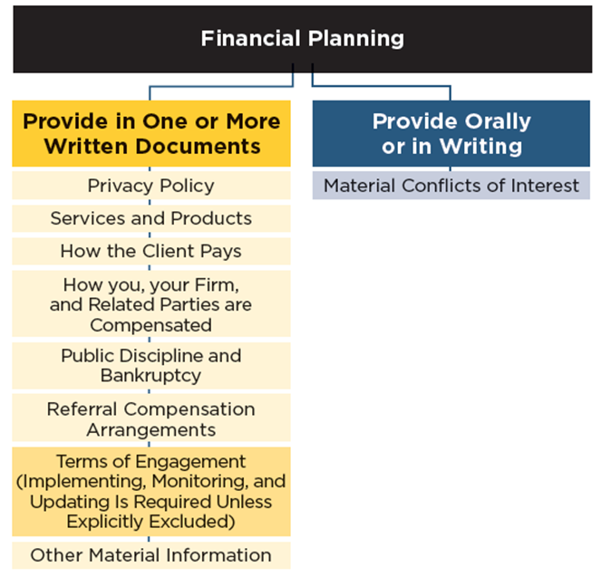
Duty to Provide Information- Financial Planning
Notes:
Provide Information to a Client (Standard A.10.): The Provide Information to a Client standard sets forth eight specific types of information that must be provided to a Client when providing or required to provide Financial Planning. Note that all information, other than the conflict of interest disclosure described in A.10.a.v., must be provided in one more written documents.
1. A description of the services and products to be provided. (Standard A.10.a.i.)
2. How the Client pays for the products and services, and a description of the additional types of costs that the Client may incur, including product management fees, surrender charges, and sales loads. (Standard A.10.a.ii.)
3. How the CFP® professional, the CFP® Professional’s Firm, and any Related Party are compensated for providing the products and services. (Standard A.10.a.iii.)
4. The existence of any public discipline or bankruptcy and the location(s), if any, of the webpages of all relevant public websites of any governmental authority, self-regulatory organization, or professional organization that sets forth the CFP® professional’s public disciplinary history or any personal bankruptcy or business bankruptcy where the CFP® professional was a Control Person. (Standard A.10.a.iv.)
5. The information required under Section A.5.a (Conflict of Interest Disclosure) (Standard A.10.a.v.)
6. The information required under Section A.9.d. (Written Notice Regarding Non-Public Personal Information) (Standard A.10.a.vi.)
7. The information required under Section A.13.a.ii. (Disclosure of Economic Benefit for Referral or Engagement of Additional Persons) (Standard A.10.a.vii.)
8. A catch-all that requires disclosure of “any other information about the CFP® professional or the CFP® Professional’s Firm that is Material to a Client’s decision to engage or continue to engage the CFP® professional or the CFP® Professional’s Firm.” (Standard A.10.a.viii.)

Slide 68
l.o.6: REQUIRED EXERCISE 3
REQUIRED: Please open the document, identify the different sections, and identify the different categories listed in the document.
Document | Compliance Resources Location
FINANCIAL PLANNING ENGAGEMENTS COMPLIANCE CHECKLIST | Page Link: https://www.cfp.net/ethics/compliance-resources/2020/06/compliance-checklist-financial-planning-engagements Document PDF Link: https://www.cfp.net/-/media/files/cfp-board/standards-and-ethics/Compliance-Resources/CFP-Board-Guidance-FP-Checklist.pdf
4

Slide 69
Timing, Delivery, and Updating
Timing -The required information must be provided prior to or at the time of the Engagement.
Delivery - Does not require the information be provided to the Client in writing when the CFP® professional is only providing Financial Advice. However, a CFP® professional must document the fact that the information was provided to the Client.
Updating A CFP® professional has an ongoing obligation to provide to the Client any information that is a Material change or update to the information required to be provided to the Client.
Notes:
Timing (Standard A.10.a.). Now we will discuss the timing of the delivery. The required information must be provided prior to or at the time of the Engagement. This language mirrors the instructions for investment advisors when delivering the Form ADV Part 2 brochure.
Delivery (Standard A.10.a.). The Code and Standards does not require the information be provided to the Client in writing when the CFP® professional is only providing Financial Advice. However, a CFP® professional must document the fact that the information was provided to the Client. This can be achieved, for example, by making a note in a CRM system. The Code and Standards does require CFP® professionals providing Financial Planning to provide the information to the Client in writing. CFP® professionals may provide the required information to a Client in one or more written documents. A CFP® professional is not required to provide Material Conflicts of Interest information in writing. However, the Code and Standards states that evidence of oral disclosure of a conflict will be given such weight as CFP Board in its judgment deems appropriate.
Updating (Standard A.10.d.). A CFP® professional has an ongoing obligation to provide to the Client any information that is a Material change or update to the information required to be provided to the Client. Material changes and updates to public disciplinary history or bankruptcy information must be disclosed to the Client within ninety days, together with the location(s) of the relevant webpages that publish the disciplinary actions and bankruptcies.

Slide 70
Case study videos
Review

Slide 71
Review case study Videos
For each case study video,
Play the video and initiate review discussion
Case Study | Compliance Resources Location
THE FIDUCIARY DUTY APPLIES TO AN OPINION ABOUT A FINANCIAL ASSET | https://www.cfp.net/ethics/compliance-resources/2020/03/case-study-the-fiduciary-duty-applies-to-an-opinion-about-a-financial-asset
THE DUTY TO DISCLOSE MATERIAL CONFLICTS OF INTEREST WHEN MAKING A ROLLOVER RECOMMENDATION | https://www.cfp.net/ethics/compliance-resources/2020/03/case-study-the-duty-to-disclose-material-conflicts-of-interest-when-making-a-rollover-recommendation
THE FIDUCIARY DUTY TO OBTAIN FACTUAL INFORMATION WHEN WORKING ON A TEAM | https://www.cfp.net/ethics/compliance-resources/2020/06/the-fiduciary-duty-to-obtain-factual-information
4

Slide 72
Resources
Many resources related to the Ethics CE program can be found at: https://www.cfp.net/ethics/compliance-resources
Additionally, more general information about the CFP Board Code of Ethics and Standards of Conduct can be found on this page: https://www.cfp.net/ethics/our-commitment

Slide 73
THANK YOU.

